Slide 1
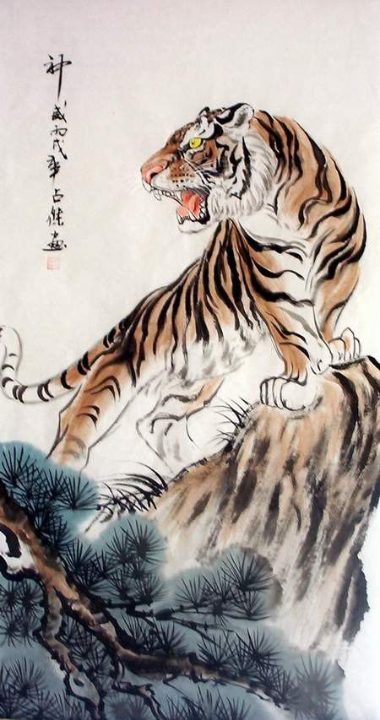
The Jungle Game
Chesshire Coders
Image from: http://www.tattoodaze.com/tattoo-images/79/th_tiger-art-decor-mountain-tiger-tiger-hand-painting-original-bkLbwV.jpg

Slide 2








Description of The Jungle Game
The Jungle Game is the english name for a traditional Chinese game called Dou Shou Qui.
Jungle is a two-player strategy game.
Each player starts with eight pieces.
Rat
Cat
Fox
Dog
Leopard
Tiger
Lion
Elephant
The higher the piece’s number, the more powerful it is.
Images from: http://liacs.leidenuniv.nl/~visjk/doushouqi/about.html

Slide 3
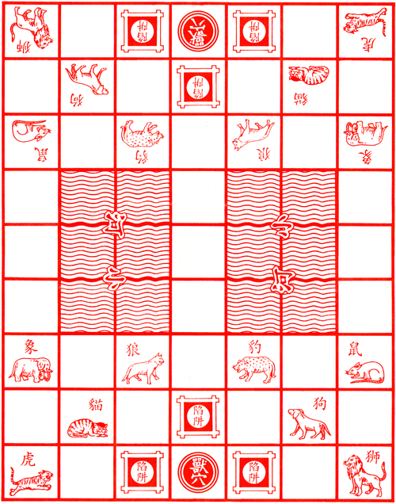



Jungle - The Board
The Jungle game board is a set of 7 by 9 squares.
With three important kinds of squares.
The “Den” Square
A “River”
https://upload.wikimedia.org/wikipedia/commons/2/2f/Dou_shou_qi_den.png
The “Trap” Squares
https://upload.wikimedia.org/wikipedia/commons/a/a4/Dou_shou_qi_river.png
https://upload.wikimedia.org/wikipedia/commons/d/d0/Dou_shou_qi_board.png
https://upload.wikimedia.org/wikipedia/commons/d/d8/Dou_shou_qi_traps.png

Slide 4
Jungle Rules
To win Jungle one of the players must move any of their pieces to occupy the same square as the enemy Den.
A player can move any creature one horizontal or vertical space each turn.
If any animal stops on an enemy animal with an equal or lower number, the lower animal is removed from the game. Except for the Rat who may capture the Elephant, and the Elephant who may not capture the Rat.
Rat
But, Never Diagonally.
Elephant
Images from: http://liacs.leidenuniv.nl/~visjk/doushouqi/about.html

Slide 5
Jungle Rules - Continued
The Lion and the Tiger are the only creatures which can “jump” the river. Moving vertically or horizontally across the water, directly to the space across from them..
The Rat is the only creature which may enter the water. The Rat may not enter the same square of an animal when leaving or entering the water.
Rat
River
Only if there are no animals in any space they cross.
But, they can land on an enemy animal with an equal or lower number, or power, than themselves, defeating them like normal.
https://upload.wikimedia.org/wikipedia/commons/a/a4/Dou_shou_qi_river.png
Images from: http://liacs.leidenuniv.nl/~visjk/doushouqi/about.html unless otherwise noted.

Slide 6
Jungle Rules - Continued
Although the animals can only defeat enemies less powerful, or lower in number, than themselves. There is a space which makes all creatures vulnerable.
Any creature which occupies the same square as an enemy trap space may be captured by any other enemy animal. There is no limit to this weakness, from Rat to Elephant.
The “Trap” Squares
https://upload.wikimedia.org/wikipedia/commons/d/d8/Dou_shou_qi_traps.png

Slide 7
Actors and Stakeholders
Owner
No account, interest in functional, fun game.
Unregistered Users
No accounts, no ability to use system
Registered Users
Create games, view profiles, etc.
Players
People who are in at least one active game

Slide 8
Use Cases
Register to the system
Log in to System
Create a new game
Invite other users to a game
Respond to Game Invitation
Join Game
Start Game
Move Game Piece
Switch Game
Quit Game
View Player Profile
Unregister from System
Log out of System

Slide 9
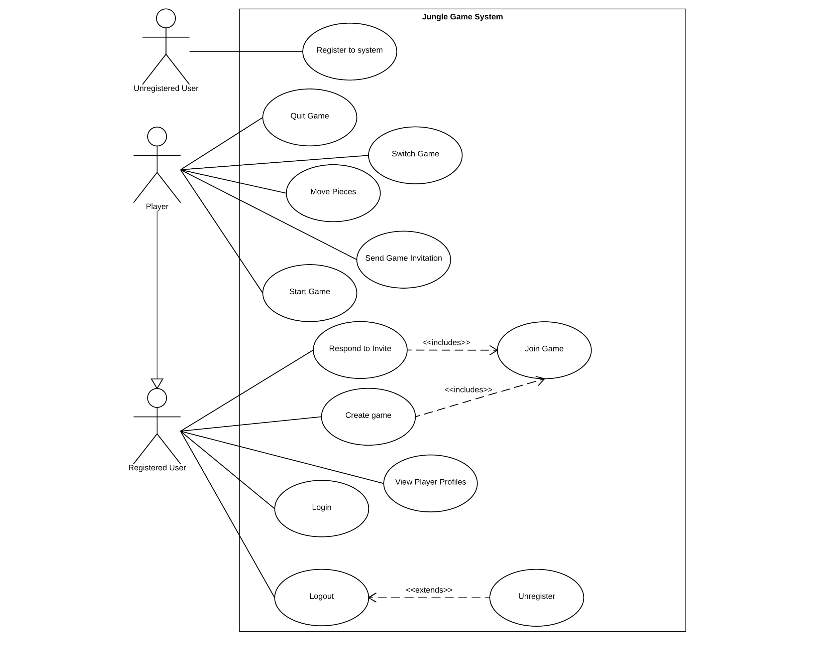
Use Case Diagram

Slide 10
Product and Process Decisions
After reviewing the websites it was decided that we would make the recommended changes to add complexity and fun to the game, along with accurate animals.
E.g. Rats and Elephant rules. Foxes instead of wolves being weaker than dogs.
We decided some of the representation and game management we want to do will need to wait until we start work on the UI. Over complexity is something to avoid.
After debate we decided that starting the game should be controlled by the player exclusively.
We decided players must actively quit a game when it ends, rather than auto removal.
And More

Slide 11
Questions
and
Discussions

